Slide 1
Getting to know your employee-to-be
Géza Orgován

Slide 2
Me, in bullet-points:
Oldest descendant with 6 siblings
Science and math-focused studies
Technical manager degree
Junior developer studies in progress

Slide 3
In my spare time
I love sports: running, badminton, foosball, billiards, table tennis
Really into travelling, exploring the hidden gems in cities
Participating in team-building events

Slide 4
My current level of programming knowledge & experience
HTML &CSS
CLI (node, git)
Typescript & javascript:
ARRAYS, OBJECTS
FUNCTIONS
DATA STRUCTURES
DRAWINGS
DIAMONDS

Slide 5

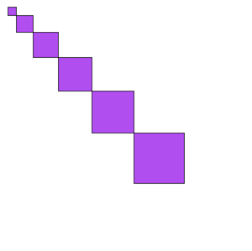
task- REPRODUCE THIS:
A QUICK LOOK INTO MY WAY OF THINKING

Slide 6
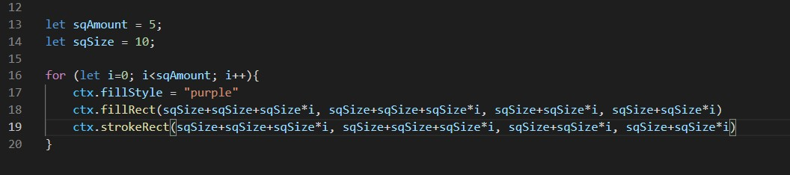
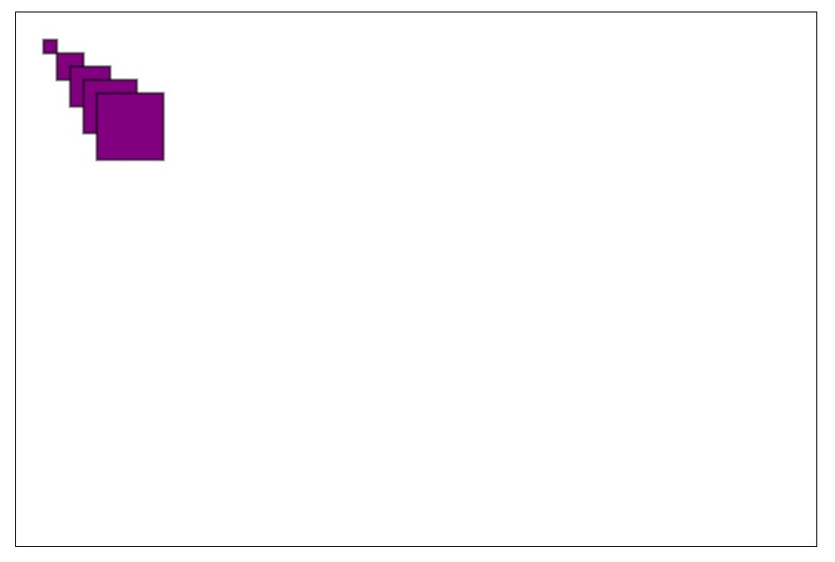
TRY - 1
Basic inputs declared
Decided on the amount of growth in each loop
Just added this amount to the starting offset

Slide 7
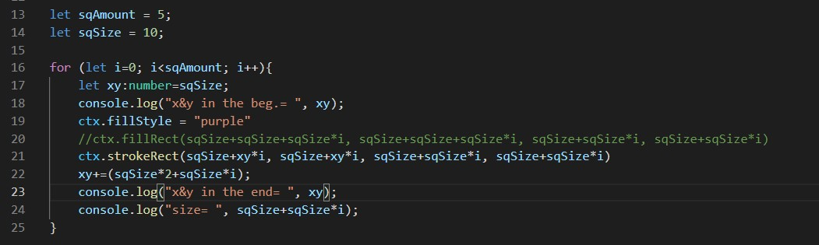
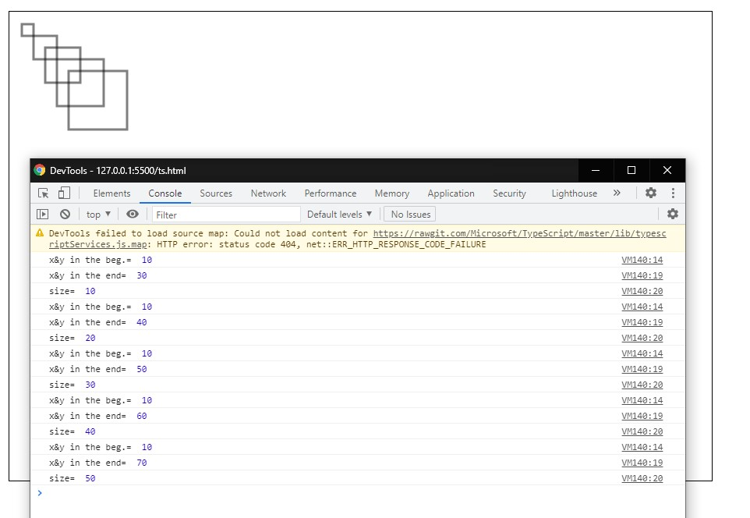
TRY - 2
Inserted console.logs for debugging
Turned off the filled square temporally
Declared a new variable for the growth amount for a better understandable code
Realized that the offset amount needs to be duplicated in each round
Realized that the new var gets re-declared in each loop

Slide 8
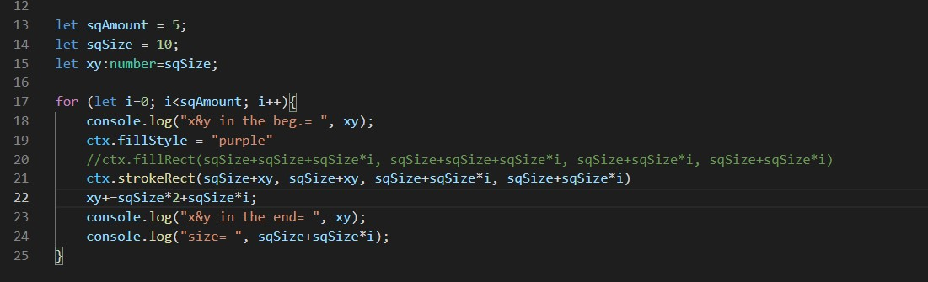
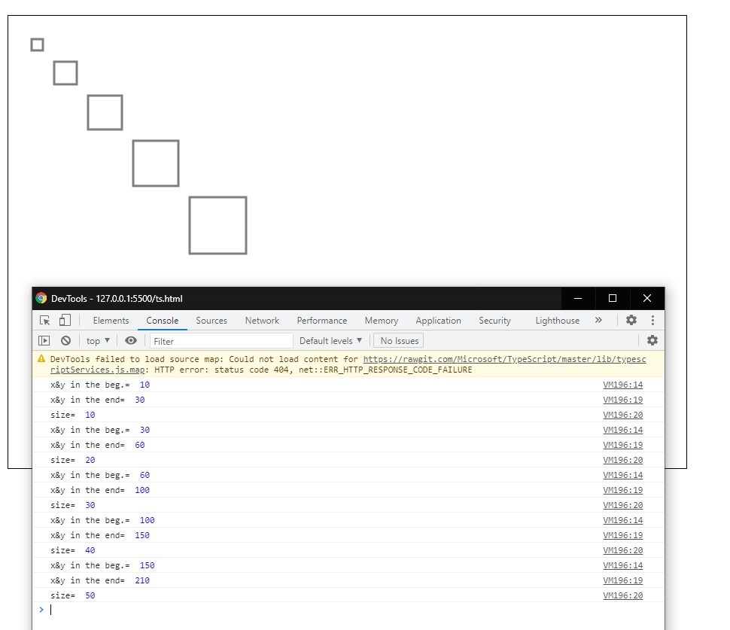
TRY - 3
Re-located the declaration outside the for loop
Removed the multiplication of the offset variable by the number of loops
Realized that the offset is unnecessarily being added in each round

Slide 9
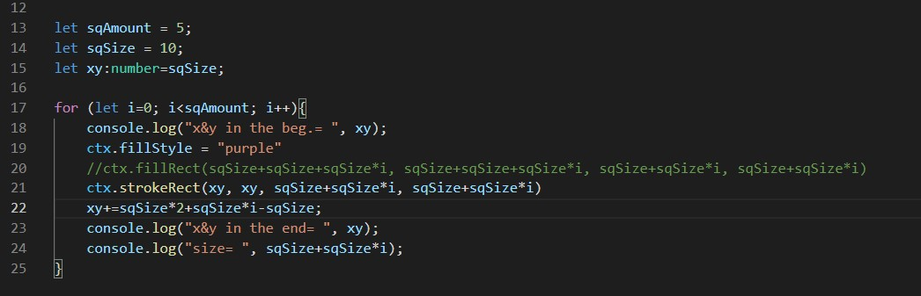
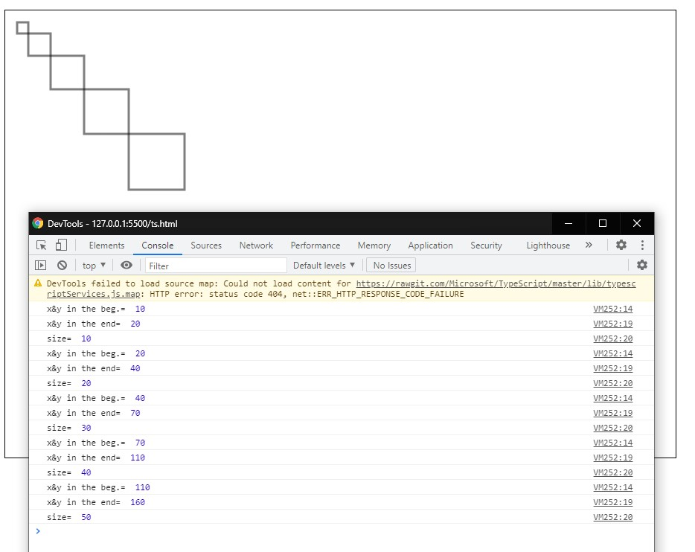
Finalisation
Removed the extra offset
Removed one amount of sqSize of the re-declaration, so they would touch

Slide 10
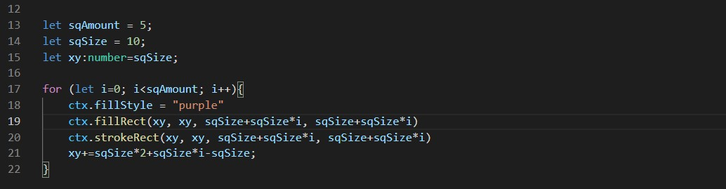
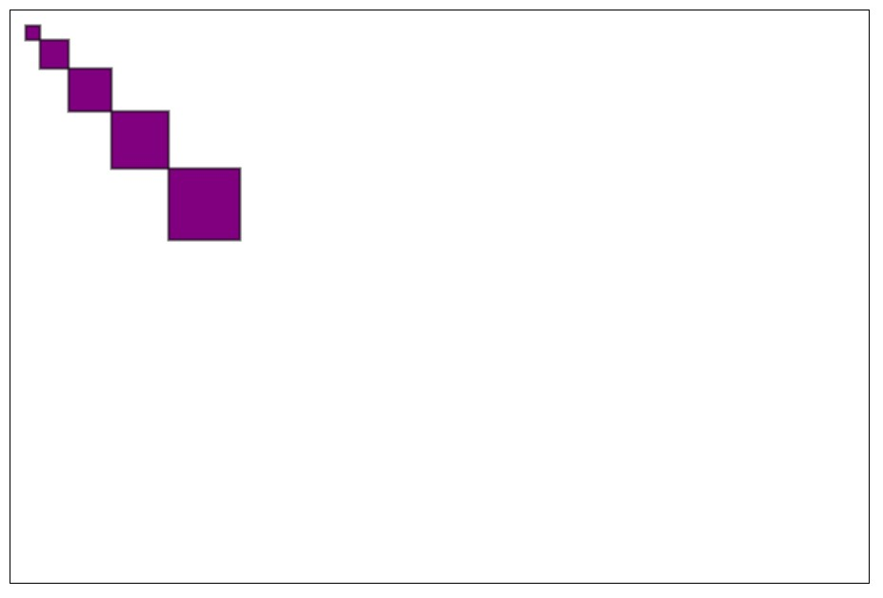
TRY - 5
Cleared the console.logs
Turned back the filled rectangles
Checked if it’s working with different input values as well

Slide 11
My wishes for my future carrier
Keep up with the trends
Continuously improve my skills
Inspire my colleagues

Slide 12
Slide Tite
Thank you for the attention!

